Slide 1


Slide 2

Business Etiquette - 7

Slide 3

GET TO THE POINT-SUMMARIZE YOUR SUBJECT IN THE FIRST PARAGRAPH

Slide 4

What is a Summary?
Summary : The process of distilling key information from a longer document or communication into a concise, clear, and easily digestible format.
It is a brief statement or restatement of main points , especially as a conclusion to a work . It is written entirely on your own words.
Purpose: To provide a quick overview that allows the reader to understand the main points without needing to read the entire document.

Slide 5

Importance of Summary in Business
Time-Saving: Busy professionals can quickly grasp essential information, making decisions more efficiently.
Clarity: Helps to distill complex information into a simpler form, enhancing understanding.
Focus: Emphasizes the most important points, ensuring they are not lost in less critical details.
Communication: Facilitates clearer and more effective communication among team members and stakeholders.

Slide 6

Key Characteristics of an Effective Summary
Conciseness: Avoid unnecessary details; stick to the main points.
Clarity: Use clear and straightforward language.
Relevance: Include only the information that is pertinent to the purpose of the summary.
Accuracy: Ensure the summary accurately reflects the original content.
Overall A good summary describes the most important information of the passage as a whole, not just the beginning and the end, not just the middle, not just any part, but as a whole.

Slide 7
Steps in Writing a Business Summary
Read Thoroughly: Understand the full document before attempting to summarize.
Identify Key Points: Highlight or note the main ideas, arguments, or findings.
A summary must be comprehensive : You should isolate all important points and note down them in a list.
Draft the Summary: Write a draft that includes all key points in a concise manner.
Revise and Edit: Ensure clarity, conciseness, and accuracy. Remove any redundant information.
Format Properly: Use headings, bullet points, or numbered lists to organize the summary for easy reading., if necessary.

Slide 8
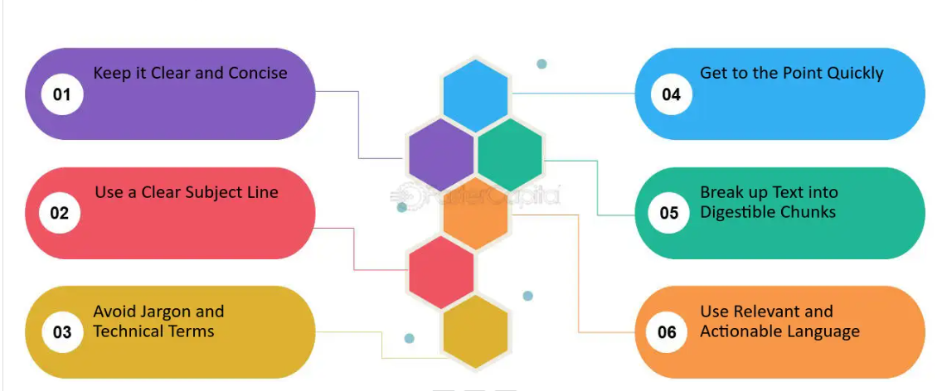
Clarity And Conciseness

Slide 9
Conciseness And Clarity-Cornestone Of A Summary
A summary must be concise-Eliminate repetitions, even if the author restates the same points.Your summary should be considerably shorter than source.You need not include every repetition of a point or every supporting detail.
A summary must be coherent-It should make a sense as a piece of writing in its own right; it should not merely be taken directly from your list of notes or sounds like disjointed collection of points.
Clarity of Thought-A summary contains only the ideas of the original text. Do not insert any of your own opinions, interpretations, deductions or comments into a summary.

Slide 10

Types of Business Summaries
Executive Summary
Email summary
Meeting summary

Slide 11

Executive Summary
Executive Summaries: Often used in reports, proposals, and business plans to provide a snapshot of the key content.
Begin with a clear statement of the document’s purpose and the main objectives.Provide an overview of the scope, explaining what the document covers.
Highlight the main findings or conclusions of the document.Outline the key recommendations or actions proposed, focusing on the most critical points.

Slide 12

Email Summary
Email Summaries: Used in business communication to summarize meeting discussions, project updates, or decisions.
Begin the email with a clear statement of its main purpose or objective.Ensure the recipient immediately understands the reason for the email.
Use bullet points or numbered lists to organize information for easy reading. Provide deadlines or timelines if applicable to ensure clarity and urgency.

Slide 13

Meeting Summary
Meeting Summaries:Capture the main points, decisions, and action items from business meetings
Document all major decisions made during the meeting. Clearly list any action items assigned, including who is responsible and the deadlines.
Highlight significant insights, ideas, and conclusions reached during the meeting.Include the meeting date, time, and attendees to provide context and reference.

Slide 14

Summary-Body, Make it relevance to the Audience

Slide 15

Audience analysis
It is the process of understanding the characteristics, needs, and expectations of the people who will be reading or listening to your summary. Conducting an audience analysis helps ensure that your summary is relevant, engaging, and effective in communicating the intended message.

Slide 16

Steps for Audience Analysis
Identify the Audience:
Who are they? Determine the specific group or groups of people who will be reading the summary. This could include executives, employees, clients, stakeholders, or a general audience.
Demographics: Consider demographic factors such as age, gender, education level, professional background, and cultural context.
Purpose: Why are they reading the summary? Are they looking for a quick overview, detailed insights, or actionable recommendations?

Slide 17
Steps for Audience Analysis
Interests: What aspects of the original document are most relevant to them? This could include key findings, decisions made, financial implications, or strategic plans.
Concerns: What questions or concerns might they have? Anticipate potential areas of confusion or interest that need to be addressed.
Familiarity with the Topic: Determine how much the audience already knows about the topic. Are they experts, novices, or somewhere in between?
Technical Jargon: Decide whether to use specialized terminology or to explain concepts in simpler terms.

Slide 18

Incorporating Audience Analysis into Summary Writing

Slide 19
Incorporating Audience Analysis into Summary Writing
Tailor the Content:
Relevance: Include information that directly addresses the audience’s interests and needs. Omit details that are irrelevant to them.
Clarity: Use language and examples that are familiar and easily understood by the audience.
Highlight Key Points:
Prioritize Information: Emphasize the points that are most important to the audience. Place critical information at the beginning to capture their attention.
Use Headings and Bullet Points: Organize the summary with clear headings and bullet points to make it easy for the audience to scan and find the information they need.

Slide 20
Incorporating Audience Analysis into Summary Writing
Provide Context:
Background Information: Offer sufficient background information to help the audience understand the context of the summary.
Explanations: Explain any technical terms or concepts that might be unfamiliar to the audience.
Engage the Audience:
Tone and Style: Adjust the tone and style of the summary to match the audience’s preferences. For a formal audience, use a professional tone; for a general audience, a more conversational style might be appropriate.
Visuals: Incorporate visuals like charts, graphs, or images if they help convey the message more effectively to the audience.

Slide 21
QUESTION 1
What is the purpose of summarizing the subject in the first paragraph of a business document?
To confuse the reader
To provide detailed information
To grab the reader's attention and provide an overview
To hide important details and create suspense
Notes:
ANS:3

Slide 22
QUESTION 2
Which of the following strategies is effective for summarizing the subject in the first paragraph?
Using complex language
Providing irrelevant background information
Using clear and concise language to convey the main idea
Omitting any mention of the subject to maintain mystery
Notes:
ANS:3

Slide 23
QUESTION 3
How should you determine what information to include in the first paragraph summary?
By providing as much detail as possible
By including personal anecdotes and opinions
By focusing on the most important points related to the subject
By listing all possible topics without prioritization
Notes:
ANS:3

Slide 24
QUESTION 4
What should be the tone of the first paragraph when summarizing a subject in business etiquette?
Formal and distant
Casual and informal
Excited and enthusiastic
Neutral and professional
Notes:
ANS:4

Slide 25
QUESTION 5
Which of the following best describes the length of the first paragraph summary?
Several paragraphs
A single sentence
One or two concise paragraphs
A lengthy description of the topic
Notes:
ANS:3

Slide 26
QUESTION 6
What role does the first paragraph summary play in engaging the reader?
It discourages further reading by providing too much information
It intrigues the reader and encourages them to continue reading
It confuses the reader with ambiguous language
It overwhelms the reader with technical jargon
Notes:
ANS:2

Slide 27
QUESTION 7
How should you ensure clarity when summarizing the subject in the first paragraph?
By using vague language
By including unnecessary details
By avoiding repetition and staying focused on the main idea
By excluding any mention of the subject to maintain suspense
Notes:
ANS:3

Slide 28
QUESTION 8
What should be the primary focus when summarizing the subject in the first paragraph?
Providing background information
Highlighting irrelevant details
Clearly conveying the main idea
Confusing the reader with conflicting information
Notes:
ANS:3

Slide 29
QUESTION 9
How can you gauge the effectiveness of the first paragraph summary?
By assessing the reader's confusion
By tracking reader engagement and understanding
By ignoring reader feedback and opinions
By providing irrelevant information
Notes:
ANS:2

Slide 30
QUESTION 10
Which of the following examples demonstrates an effective first paragraph summary?
This document will discuss various topics related to the subject.
In this document, we will explore the history of the topic.
This document provides a comprehensive overview of the subject.
The topic is complicated and requires further explanation.
Notes:
ANS:3

Slide 31
THANK YOU

